Slide 1
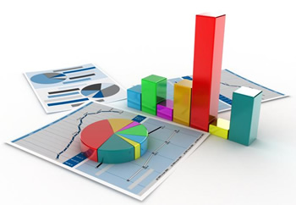
Chapter 2
Describing Distributions with Numbers

Slide 2

Chapter 1:
Data
Variable Types
Graphical representations
Categorical variables: bar chart and pie chart
Quantitative variables: histogram and stem and leaf plot
Time plot
Notes:
Most of you know what a mean, or common arithmetic average is.
You should know how to calculate the mean both by hand and using your calculator. See Dr. Baldi.

Slide 3
Outline
Measure of center : Mean and Median
Measure of Spread: Quartiles and Standard Deviation
The five number summary and box plots
IQR and outliers
Choosing among summary Statistics
Notes:
Most of you know what a mean, or common arithmetic average is.
You should know how to calculate the mean both by hand and using your calculator. See Dr. Baldi.

Slide 4
Measuring center: the mean
To calculate the average, or mean, add all values, then divide by the number of individuals.
Example 1:
Ages of kids at a nursery
2 4 3.5 3 5 4 3 2 2.5
Example 2:
2 4 3.5 3 5 4 3 2 2.5 8
Mean=
Mean=

Slide 5
2 4 3 3 5 4 3 2 2 8
n= Total number of observations
n =10

Slide 6
Mathematical notation:

Slide 7
Measuring center: the median
Example 1:
1.9 1.6 1.5 0.6 2.3 2.5 1.2 2.1 2.3
Median =
Example 2:
1.9 1.6 1.5 0.6 2.3 2.5 1.2 2.1 2.3 2.8
Median = Average of the middle pair =

Slide 8
Measuring center: the median
The median is the midpoint
→ the no. such that half of the observations are smaller and half are larger.
Steps:
Sort observations by size.
n = number of observations
If n is odd, the median is observation (n+1)/2 down the list
If n is even, the median is the mean of the two middle observations

Slide 9
Mean Vs Median
Symmetric distributions?
Skewed distributions?
Mean and median are the same.
2 3 4 5 6
The mean is pulled towards the tail.
2 3 4 5 6 7 8

Slide 10
How outliers affect the mean and the median
Example 1:
Ages of kids at a daycare
2 4 3.5 3 5 4 3 2 2.5
Example 2:
2 4 3.5 3 5 4 3 2 2.5 12
Median = 3
Mean= 3.22
Median = 3.25
Mean= 4.1

Slide 11
Your numerical summary must be meaningful
37
16
7
4
13
1
2
2
6
n=100 Mean 6.9
Is the mean an appropriate measure of center?
Notes:
While we are looking at a number of histograms at once, and talking about means, here is another example of how you might use histograms and descriptive statistics like means to find out something of biological interest.
You are interested in studying what pollinators visit a particular species of plant. Let’s say that there has been an increase in agriculture in the area with all the pesticide spraying that comes along with that. If insects are needed to pollinate the plant, and the pesticides kill the insects, the plant species may go extinct.
Here is the mean of this distribution., but is it a good description of th center? Why would we care? Maybe plant height is a measure of plant age, and we wonder how well the population is holding up. - here you see there are not very many little plants, which might make you worry that there has been insufficient pollination.
One of the things you have noticed about the plants is that the flower color varies. Pollinators are attracted to flower color, so you happen to have the plants divided up into three groups - red pink and white flowers. Typically hummingbirds pollinate red flowers and moths pollinate white flowers. Which makes you start to wonder about your sample. So group them by flower color and get means for each group.

Slide 12
Your numerical summary must be meaningful
The distribution of women’s height appears symmetrical. The mean is a good numerical summary.
Notes:
While we are looking at a number of histograms at once, and talking about means, here is another example of how you might use histograms and descriptive statistics like means to find out something of biological interest.
You are interested in studying what pollinators visit a particular species of plant. Let’s say that there has been an increase in agriculture in the area with all the pesticide spraying that comes along with that. If insects are needed to pollinate the plant, and the pesticides kill the insects, the plant species may go extinct.
Here is the mean of this distribution., but is it a good description of th center? Why would we care? Maybe plant height is a measure of plant age, and we wonder how well the population is holding up. - here you see there are not very many little plants, which might make you worry that there has been insufficient pollination.
One of the things you have noticed about the plants is that the flower color varies. Pollinators are attracted to flower color, so you happen to have the plants divided up into three groups - red pink and white flowers. Typically hummingbirds pollinate red flowers and moths pollinate white flowers. Which makes you start to wonder about your sample. So group them by flower color and get means for each group.

Slide 13
2 3 4 5 6
Measure of center alone is not sufficient and misleading!
Also need a measure of spread

Slide 14
Measuring Spread
One way to measure spread is to give the smallest and largest observations. Outliers?
Quartiles :Five number summary
Standard Deviation

Slide 15
Measures of Spread: Quartiles
Quartiles
Find the median
Divide the data into 2 halves at the median
First quartile Q1: This is the Median of lower half
Third quartile Q3: This is the Median of upper half

Slide 16
Quartiles
2 4 5 7 8 9 12 13 13 15 18 19 20 23 23 36 59
Q1=7.5
Q3=21.5

Slide 17
Five-number summary
2 4 5 7 8 9 12 13 13 15 18 19 20 23 23 36 59
n=17
Minimum
Q1
Median
Q3
Maximum
Note: Median is ignored when finding the quartiles when n is an odd number.
=
=
=
=
=

Slide 18
Note:
If n is odd →Leave the Median out when finding the quartiles
If n is even → Use all the observations when finding the quartiles

Slide 19
Box plot
A boxplot is a graph of the five number summary
A central box spans the quartiles Q1 and Q3
A line in the box marks the Median
Lines extend from the box out to the smallest and largest observations
Box plot show less detail than histograms or stem plots.

Slide 20
Box plot
Min=2, Q1=7.5, Med=13, Q3=21.5, Max=59
0 5 10 15 20 25 30 35 40 45 50 55 60
Inter quartile range IQR = Q3- Q1
The quartiles are resistant because they are not affected by a few extreme observations.

Slide 21
Try it!
Compute the Five num summary and IQR
2 11 15 21 14 16 18 22 56 14 23 88
Order them

Slide 22
Five-number summary
2 11 14 14 15 16 18 21 22 23 56 88
n=12
Minimum
Q1
Median
Q3
Maximum

Slide 23

Spotting Outliers

Slide 24
Five-number summary
2 11 14 14 15 16 18 21 22 23 56 88
n=12
Minimum
Q1
Median
Q3
Maximum
IQR =
1.5*IQR =
Q3+ 1.5*IQR
Q1- 1.5*IQR

Slide 25
Box plot
Min=2, Q1=14, Med=17, Q3=22.5, Max=23
0 10 20 30 40 50 60 70 80 90

Slide 26
Measuring spread: the quartiles
The five-number summary and boxplots
Spotting suspected outliers*
Standard Deviation

Slide 27
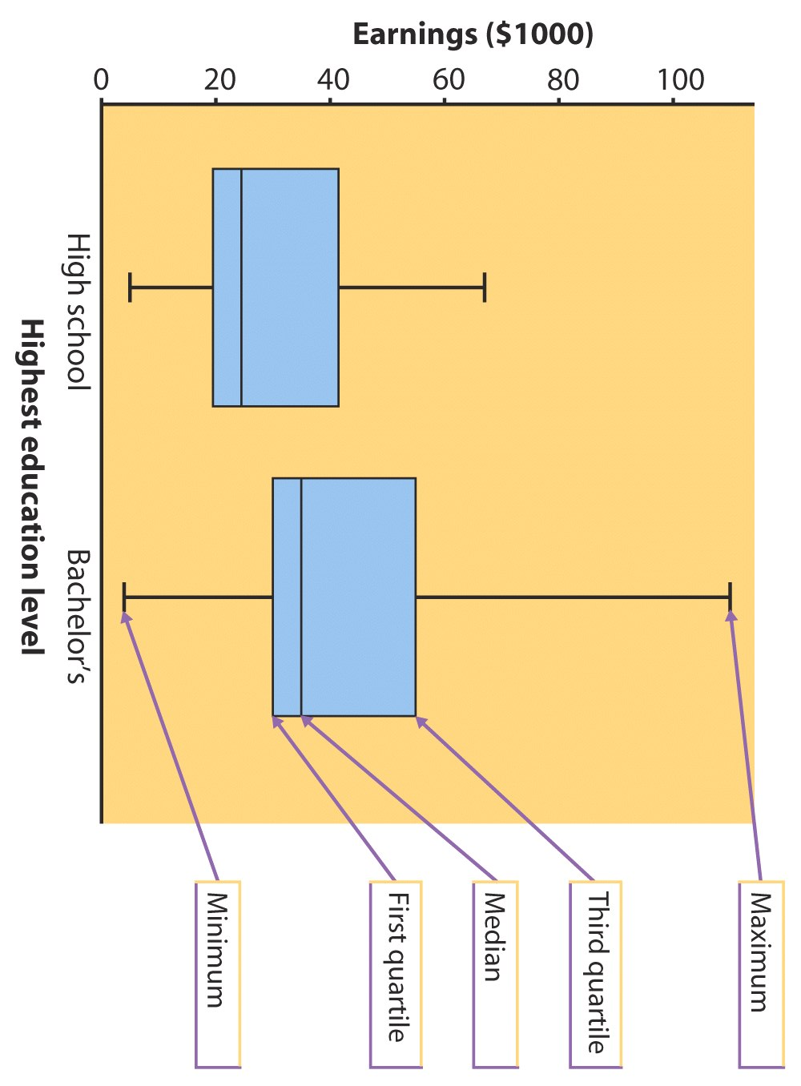
Median Earnings with High School education =
Median Earnings with a Bachelor’s =
IQR for those with HS?
=
IQR for those with Bachelors?
=
Among those with a Bachelor’s degree, about ______ % earn more than $30K
Among those with HS education, about 25% earn less than

Slide 28
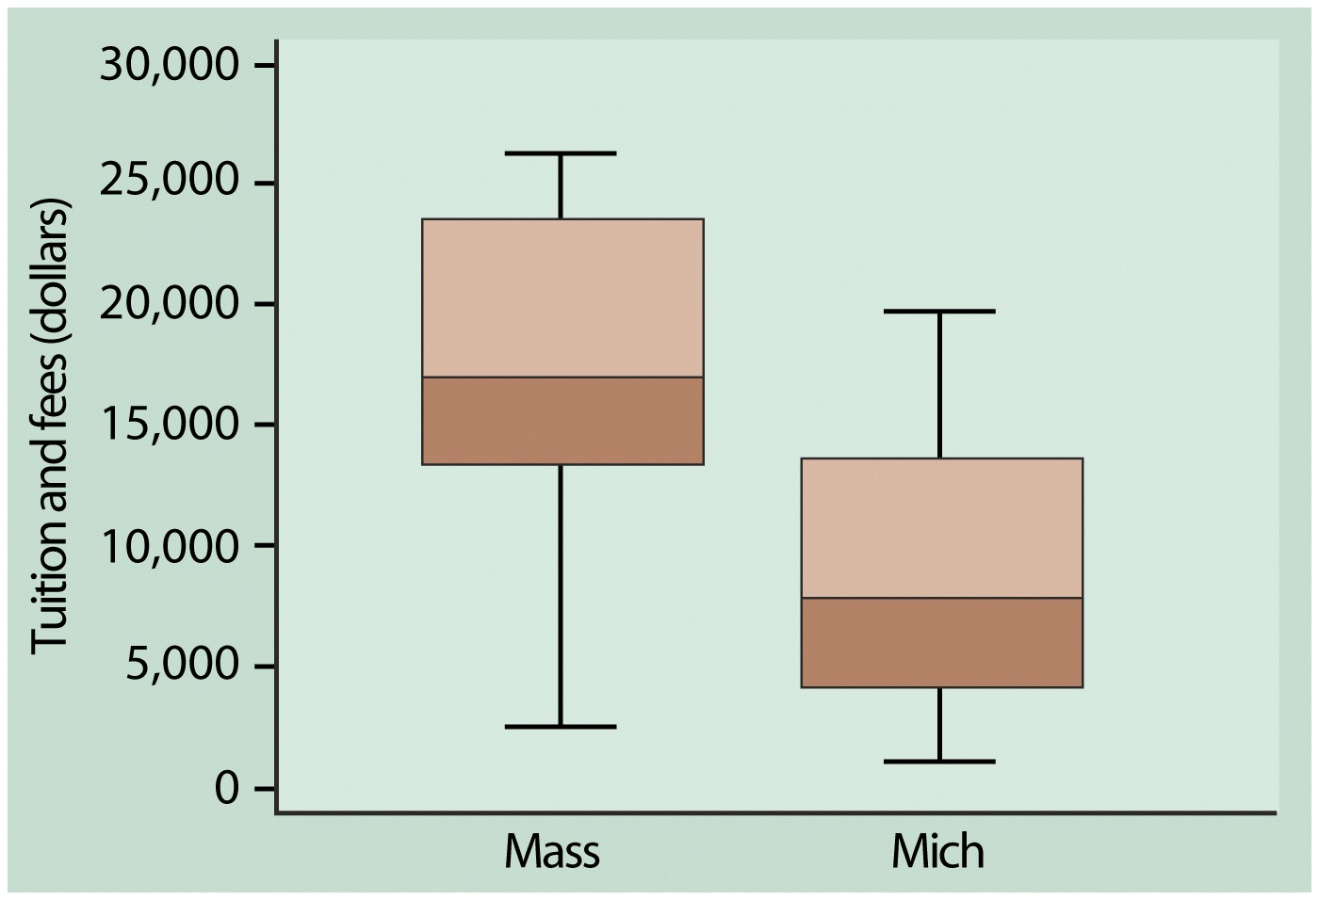
Tuition fees is higher in Mass than in Mich in general.
Tuition fees is higher than 13k in 75% of schools in Mass.
Tuition fees is higher than 13k in for only 25% of schools in Mich.

Slide 29
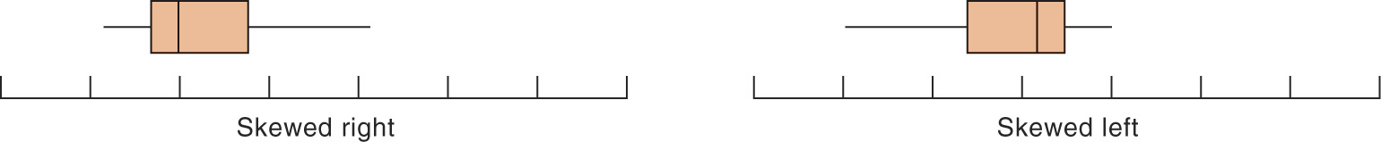
Boxplots for skewed data
What would a box plot for a symmetric distribution look like?
Notes:
They are most useful for comparing two things.
Here we see immediately that they are different beasts.
Start at the bottom - you can die of either in the first year,
The first quarter of individuals die of disease X in 2 years, only takes 1 for MM
Medians, or point at which half are dead, are not too different - 3 1/2 vs 2 1/2
For both diseases 3/4 of people are dead by about 4.5 years.
Disease X kills everyone by year 6 while some people with MM hang on a long time.
Quite obvious that the distribution of variation around midpoint is symmetric for X and highly skewed towards larger values for MM.
That is actually quite a bit of information -

Slide 30
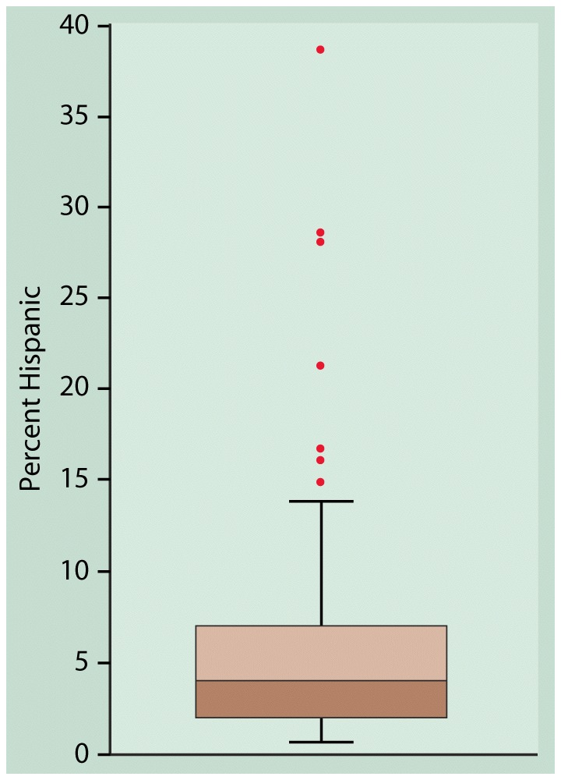
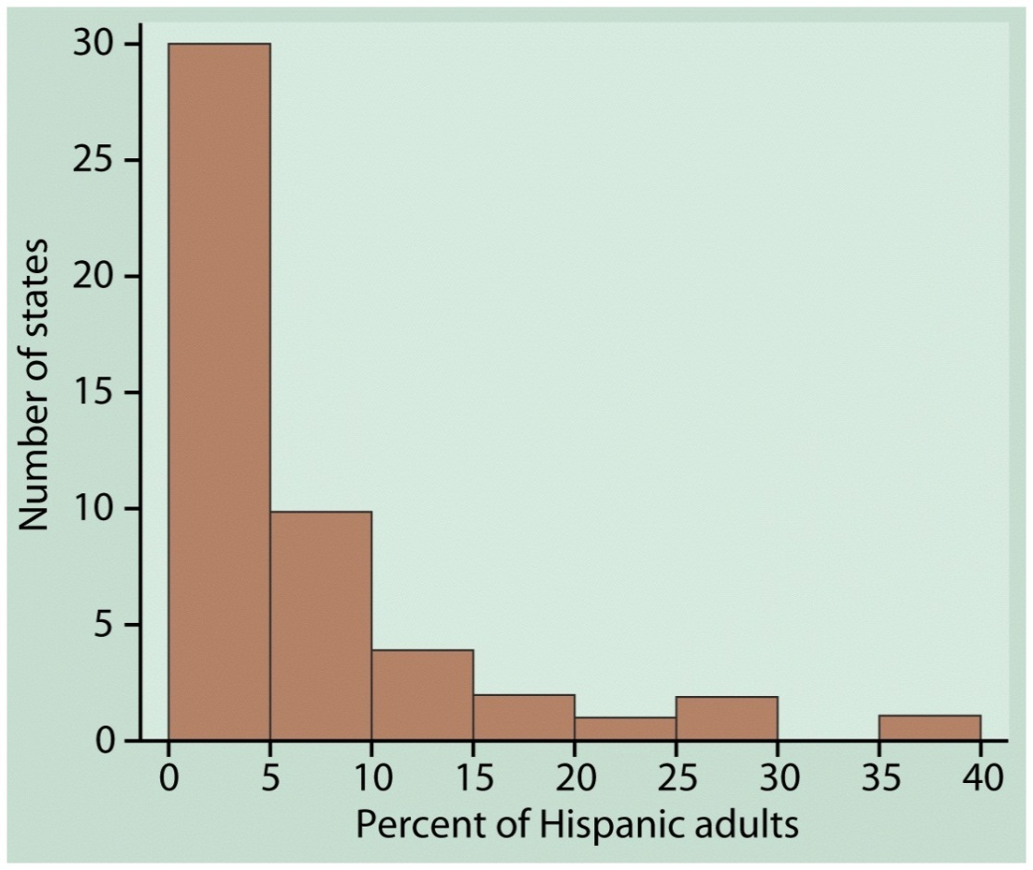
Boxplots
Can hide some details.
Best used to compare groups

Slide 31
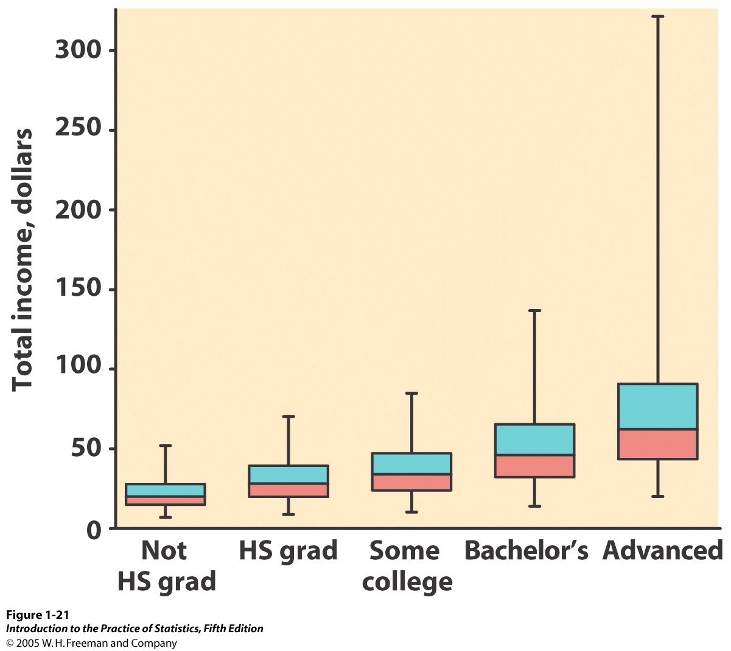
Example

Slide 32
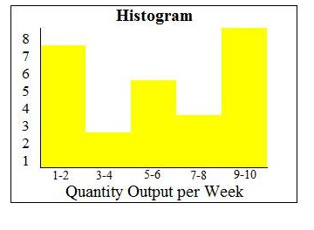
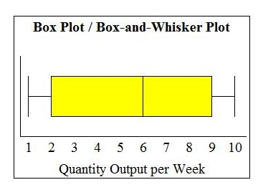
Box plot Vs Histogram
Histogram displays the complete data
Min, max, mode/s, outliers
shape
Box-plot display a summary of the data
Min, max, outliers (under the rule of 1.5*IQR rule), median
Can hide the exact shape of the data

Slide 33
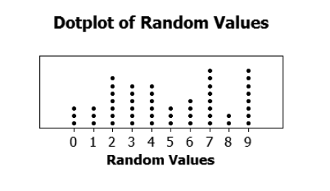
Ques
Height of 14 tress are given below
23 14 7 13 17 19 21 19 21 15 15 15 19 15
Which graph/s can be used to find the median?
Dot plot
Box Plot
Histogram

Slide 34
Ques
Mileage of 35 vehicles in a car sale was given.
Which graph/s can be used to find the number vehicles that have ran more than 20 , 000 kms?
Dot plot
Box Plot
Histogram

Slide 35
(2) Standard deviation (S)
S= “Average deviation” from the mean
2 3 4 5 6
Ages (in years) of kids at a day care

Slide 36
2 3 4 5 6
Data
Yrs →
Yrs→
Yrs²→
Yrs²→
Yrs²→
Deviations from the mean
Squared Deviations
Sum of Squared Deviations
4+1+1+0+ +……+4 = 12
Average of Squared Deviations
12
8

Slide 37
Variance →
s² = 12 = 1.5 yrs²
8
Standard Deviation →
s = 1.5 = 1.23 yrs

Slide 38
Standard deviation
S= “Average deviation” from the mean
Variance →
Standard deviation →

Slide 39
Try it!
Compute the standard deviation of 2 5 8 3 2
Find average
Find Deviations from for each value
Squared Deviations
Sum of Squared Deviations
“Average” of Squared Deviations
Square-root

Slide 40
Standard deviation Contest:
You must choose four numbers from the whole numbers 0 to 10, with repeats allowed.
(a) Choose four numbers that have the smallest possible standard deviation.
(b) Choose four numbers that have the largest possible standard deviation.
(c) Do parts (a)-(b) if no repeats are allowed.

Slide 41
Properties of S
S measures the“Average deviation” from the mean
Outliers?
Units?
S is never negative.
If S=0 → ?

Slide 42
Choosing measure of center and spread
Five-number summary → for describing skewed distributions or distributions w/ strong outlier
(Mean and Std dev) → for reasonably symmetric distributions that are free of outliers
How do we know?
ALWAYS PLOT THE DATA!

Slide 43
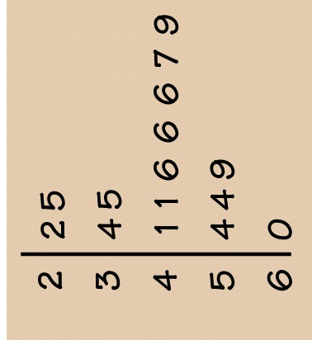
Examining a Distribution
Overall Pattern:
Shape
Modes (peaks)
Center (typical value)
Spread
Striking Deviations
Outliers
Distribution is roughly symmetric with
the mode in the 40’s.
The mean of the distribution is 43.9 and
the standard deviation is 11.2

Slide 44
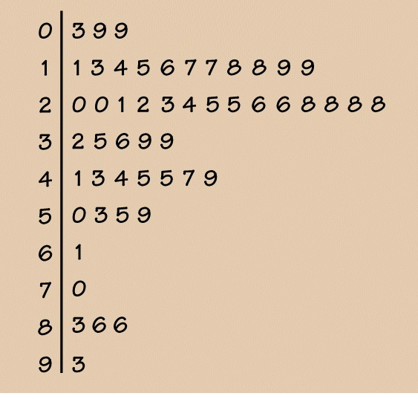
Examples
The distribution is skewed to the right with a mode in the 20’s.
The five number summary for the distributions is
min =3,
Q1=19,
Med=28,
Q3=46,
Max=93
Average 35, standard deviation 21.8

Slide 45
Organizing a statistical problem
STATE: What is the practical question, in the context of a real-world setting?
FORMULATE: What specific statistical operations does this problem call for?
SOLVE: Make the graphs and carry out the calculations needed for this problem.
CONCLUDE: Give your practical conclusion in the setting of the real-world setting.

Slide 46
Homework
Read Chapter 2
2.6, 2.7
2.15-2.24, 2.36, 2.42

